Slide 1

ELL Instructional Academy
Karina E. Chapa, M.Ed.
Language Proficiency, Biliteracy and Cultural Diversity Director
@esc1bilingual @bilingualpride

Slide 2

Professional Learning Essential Agreements
Be respectful of others
Be an active participant
Take care of your needs
Use electronic devices as learning tools

Slide 3
AGENDA
Second Language Acquisition
ELPS
Sheltered Instruction

Slide 4
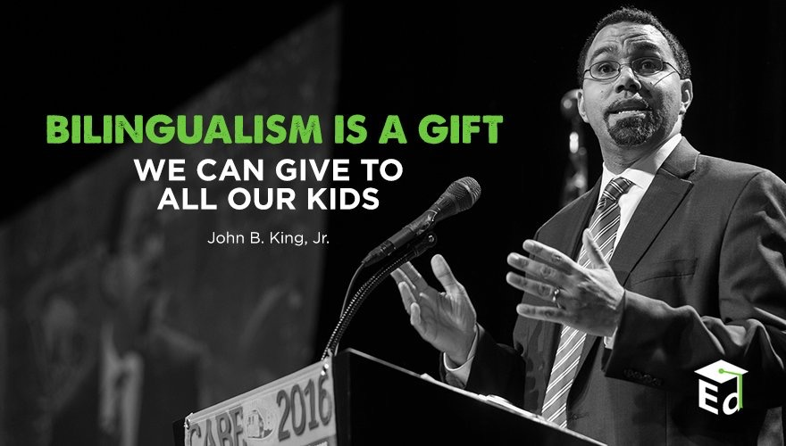
Second Language Acquisition
Notes:
45 mins

Slide 5
Session Objectives
Content Objective
Language Objective
Today I will analyze the second language acquisition process and understand its impact in the education of English Language Learners.
Today I will discuss with my peers the second language acquisition process and I will share orally and in writing my individual language profile.

Slide 6
Language Power
Cognitive
Social
Affective
“Language stands at the center of the many interdependent cognitive, affective, and social factors that shape learning”.
David Corson, 1999
LANGUAGE
=
IDENTITY
3-Step Interview

Slide 7

SLA Anticipation Guide
Let’s
kahoot.it

Slide 8
The Iceberg Theory
Basic Interpersonal Communication Skills
BICS
1-3 years
CALP
5-7 years
Cognitive Academic Language Proficiency
J. Cummins, 1981

Slide 9
Double Iceberg Theory
BICS L1 1-3 years
BICS L2 1-3 years
CALP L1+L2
5-7 years
J. Cummins, 1981

Slide 10
My Language Profile
BICS Spanish
BICS English
CALP Spanish + English
1999

Slide 11
My Language Profile
BICS Spanish
BICS English
CALP Spanish + English
2017

Slide 12
Your Turn!
BICS L1
BICS L2
CALP L1+L2
Create your own language profile
Birthday Line
Notes:
90 mins

Slide 13
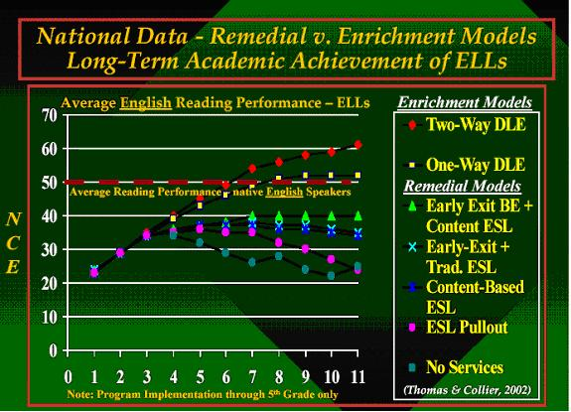
W. Thomas and V. Collier, 2002

Slide 14
Research Findings
The stronger academically and cognitively the L1, the stronger the L2.
The weaker academically and cognitively the L1, the weaker the L2.
W. Thomas & V. Collier, 2009
Turn and Talk
Think-Pair-Share

Slide 15
English vs spanish
Phonology Awareness

Slide 16
Spanish vs English Phonology
Spanish
English
Based in syllables
mamá → ma-má
manzana → man-za-na
sol → sol
Based on phonemes
cat → /k/ /a/ /t/
bat → /b/ /a/ /t/
sat → /s/ /a/ /t/
rat → /r/ /a/ /t/

Slide 17
Spanish Phonology
FRONT
CENTER
BACK
iy (igual)
uw (uva)
HIGH
ε(ego)
ow (oso)
MEDIUM
a (al)
LOW

Slide 18
English Phonology
FRONT
CENTER
BACK
iy (meat)
I (mitt)
uw (pool)
Ư (pull)
HIGH
ey (mate) ε(met)
ə (mutt)
ow (coat)
MEDIUM
æ (mat)
a (pot)
o (caught)
LOW

Slide 19
Spanish vs English Phonology
English
Spanish
5 vowels = 11+ sounds
b / v = different sounds
You
bit / bite
bow / bow / vow
bath / bathe
5 vowels = 5 sounds
b / v = same sound
Tú / Usted
Closest sound to “th” in English is “d” in Spanish
It is raining→ Está lloviendo
Life is hard → La vida es dura

Slide 20


Slide 21
Common Mistakes
Adding an “e” before an “s”
school escuela specific específico
/skUl/ /es kue la/ /spəsi fic/ /es pe si fi co/
False cognates
exit → éxito (salida)
embarrased → embarazada (avergonzada)

Slide 22
The Power of Cognates
La chimica è la scienza che studia la composizione della materia ed il suo comportamento in base a tale composizione.

Slide 23
The Power of Cognates
La chimica è la scienza che studia la composizione della materia ed il suo comportamento in base a tale composizione.

Slide 24
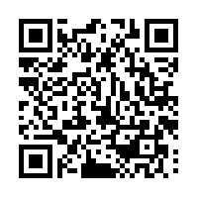
Your Turn!
1. Individually make a list of 5 academic words from any content area.
2. Turn to your partner and combine your two lists of words (even if from different content areas).
4. Write the Spanish cognates next to each academic word. Use Google Translate if needed.
5. Calculate what percentage of the words are cognates.
1 – 2 – 4 – ALL
http://www.realfastspanish.com/vocabulary/spanish-cognates

Slide 25
Factors that Impact Second Language Acquisition
Motivation and attitude
First language development
Age
Cultural background
Quality of instruction
Personality
Peers and role models
Access to the language
Language distance
Take a Stand

Slide 26
ELPS
Linguistic Instructional Accommodation Guide

Slide 27
Session Objectives
Content Objective
Today I will examine how to implement the ELPS in all content areas and how to analyze TELPAS data to guide instruction.
Language Objective
Today I will share (orally and in writing) different ideas on how to linguistically accommodate instruction for ELLs.

Slide 28
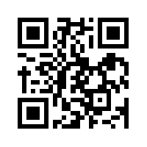
ELPS
Anticipation Guide
kahoot.it
create.kahoot.it

Slide 29
Statutory Requirement
19 Texas Administrative Code 74.4 Chapter 74. Curriculum Requirements Subchapter A. Required Curriculum 74.4 English Language Proficiency Standards
Adopted December 2007

Slide 30


ELPS Resources
LIAG and ELPS Instructional Tool

Slide 31
ELPS: How are they organized?
Big Ideas
1. Make Content Comprehensible
2. Develop Academic Language
Big Responsibilities
1. Communicated
2. Sequenced
3. Scaffolded
Student Expectations
1. Listening
2. Speaking
3. Reading
4. Writing
5. Learning Strategies
PLDs (L, S, R, W)
1. Beginning
2. Intermediate
3. Advanced
4. Advanced High

Slide 32
ELPS Mingle!
  Listening PLDs
  Listening Expectations & CCRS
  Listening Teacher Behaviors
  Speaking PLDs
  Speaking Expectations & CCRS
  Speaking Teacher Behaviors
  Reading 2-12 PLDs
  Reading Expectations & CCRS
  Reading Teacher Behaviors
  Writing 2-12 PLDs
  Writing Expectations & CCRS
  Writing Teacher Behaviors

Slide 33
TELPAS-ELPS Connection
Utilizing TELPAS to Guide Instruction

Slide 34
TEKS vs ELPS
STAAR
TELPAS
T
E
K
S
E
L
P
S

Slide 35
TEKS vs ELPS
Academic Proficiency Language Proficiency
STAAR
TELPAS
TEKS
ELPS
Relating Factor: evaluates/measures

Slide 36
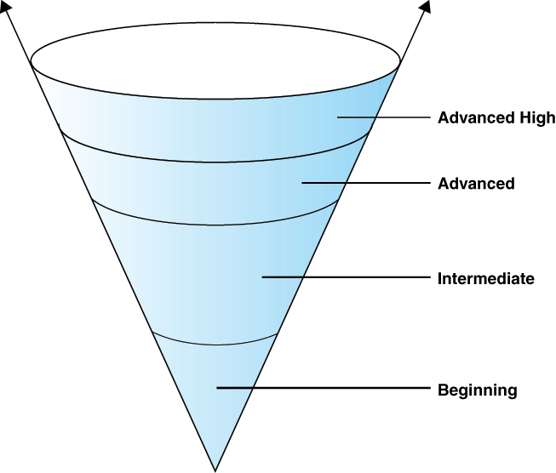
TELPAS Levels

Slide 37
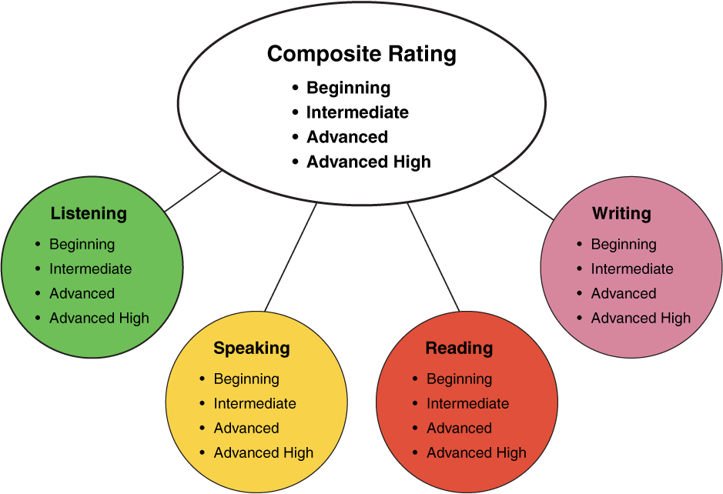
TELPAS Domains
10%
30%
10%
50%
Online

Slide 38
ELPS Resources
LIAG and ELPS Instructional Tool
+
DMAC Reports

Slide 39
DMAC TELPAS Reports
How to Run TELPAS Reports by Language Domain
Go to Home Page
Go to State Assessment
Select TELPAS
Select Instructional Reports
Select Student Language Proficiency Rating
Generate Report

Slide 40
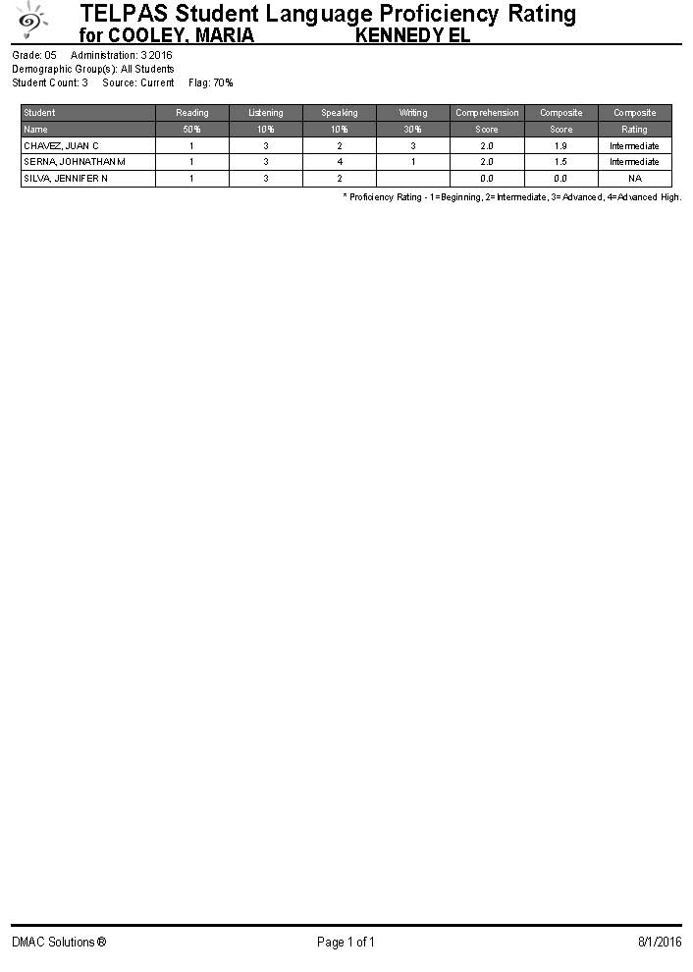
Sample DMAC Report

Slide 41
ELPS Mingle!
  Listening PLDs
  Listening Expectations & CCRS
  Listening Teacher Behaviors
  Speaking PLDs
  Speaking Expectations & CCRS
  Speaking Teacher Behaviors
  Reading 2-12 PLDs
  Reading Expectations & CCRS
  Reading Teacher Behaviors
  Writing 2-12 PLDs
  Writing Expectations & CCRS
  Writing Teacher Behaviors

Slide 42
Tickets Out
Please go back to your original seats
Talk to your partner:
  How are you planning to implement the ELPS this year?

Slide 43
Tickets Out
I used to think…
But now I know…

Slide 44
Thank you!
See you tomorrow!
Karina E. Chapa, M.Ed.
Language Proficiency, Biliteracy and Cultural Diversity Director
kchapa@esc1.net
Facebook: Region One ESC Bilingual
Twitter @esc1bilingual @bilingualpride

